Slide 1
Magni - Reinforcement Learning
Abhilesh Borode, Rachel Breshears, Casey Duncan, Emerson Ham, and Mohammed Aun Siddiqui

Slide 2
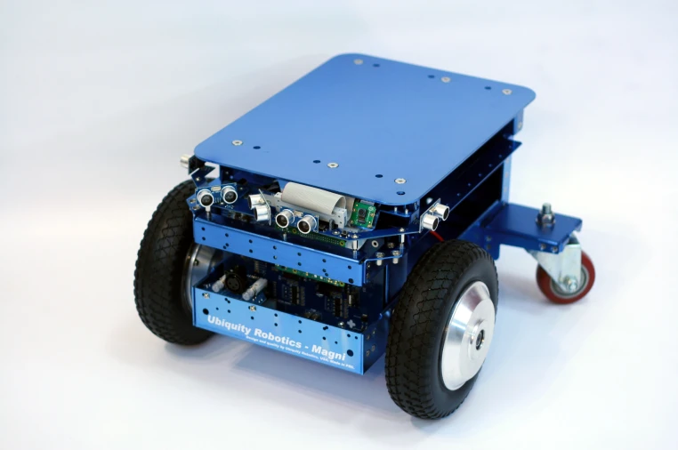
Intro
Magni Robot
RL learns to correct for motor “damage”
RL Input: Position, Orientation
RL Output: Prescribed motor velocities
Linear in X & Angular in Z
Goals of RL:
Stay as close to the line as possible
Increase the learning rate for convergence.
Notes:
Casey
Explain the real world application for our project and our approach to accomplishing it
Robots deployed more in real-world situations (e.g. post-disaster rescue)
High probability of failure (damage)
Instead of attempting to diagnose cause of failure, robots could adapt by trial- and-error (RL) in order to complete their tasks

Slide 3
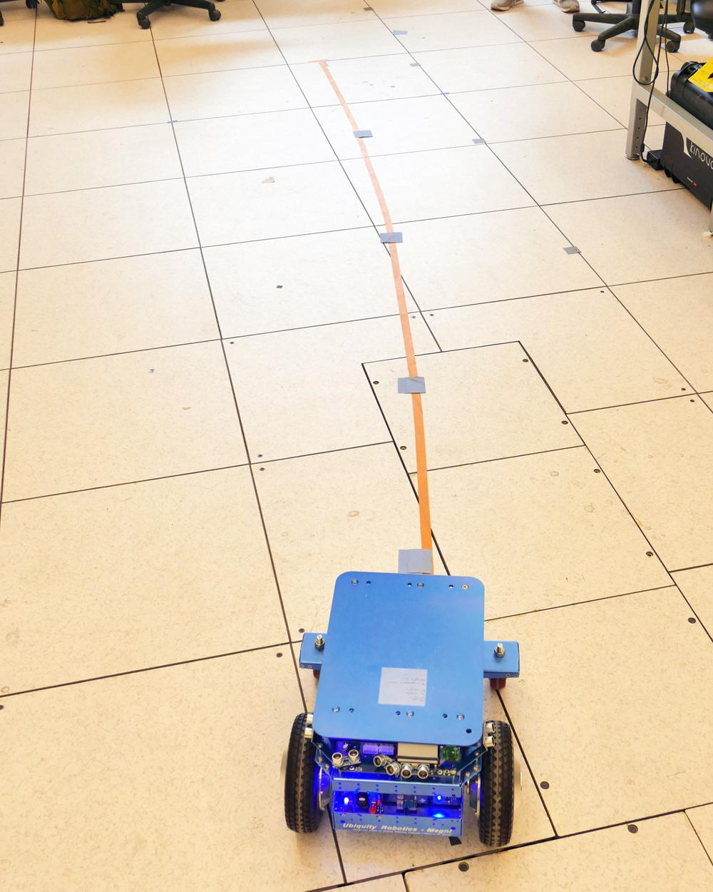
Robot Problems
Odometry- Inconsistent
Motor Damage- Inherent Speed variance
Wheel Encoder- Requires resetting
Notes:
Abhilesh
Odometry:
Poorly Calibrated
Motor Damage:
Doesn’t work as programmed
When reconfiguring the motor damage through the rqt plugin in ROS, the changes also affects odometry.
Motor Node
Dies unexpectedly
Talk about what we did to fix them

Slide 4
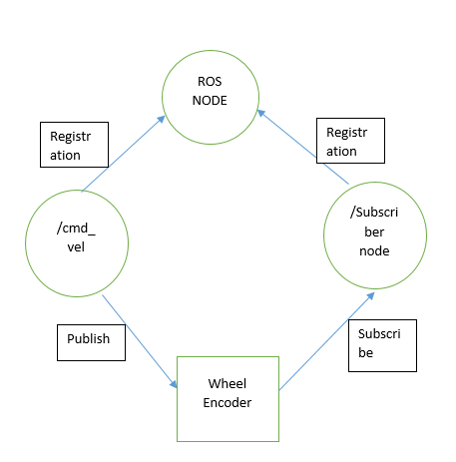
Working With ROS & C++
How ROS works
Magni’s topics
Functions for reading/writing to topics
Notes:
Abhilesh
Since a good number of people in the audience don’t have much ROS experience here’s a quick explanation of how it all works:
Topics, Subscribing and writing
Magni’s Topics:
Pose
Orientation
Motors/Moving
Our functions:
We had functions for reading the sensor values from the pose and orientation topics
Also function for publishing to the movement topic
How to run the robot:
So to bring it all together and run the robot we take these steps:

Slide 5
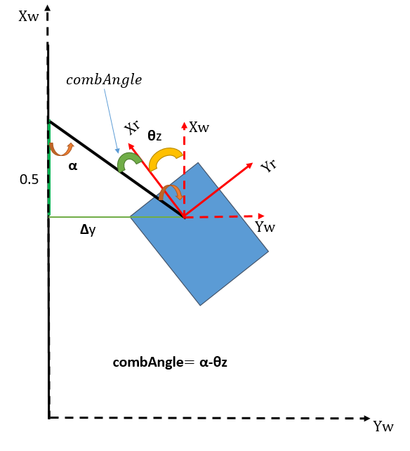
Basic RL Algorithm - Training
Similar to grid world homework assignment but better.
Algorithm:
Set the reward, learning rate, actions and states
Initialize Q matrix to 0 if first iteration or read the from file that saves the Q matrix.
Till bot reaches 4m:
Calculate old state
Select a random action * extreme state
Calculate new state
Compute reward “ reward = -abs(4.5-currentState);”
4. Write Q Matrix to a file for the next iteration
Run 2 iterations for exploring and then 1 run for implementing from the learnt Q matrix and check performance.
LOGIC BLOCK DIAGRAM?
Notes:
Aun
The algorithm we used was similar to the grid world homework assignment, however instead of the state being which grid were in, the state was the combined angle of the robot. Instead of moving between grids, the actions we used were the different prescribed rotation rates, and the reward was calculated from the final state the robot ended up in after applying the action.
Logic flow of our algorithm
Read sensors to get state
If exploring:
Apply Random action
Limit how far off the path the robot can go so we don’t waste time exploring useless actions
If implementing:
Apply optimal action
Read outcome of action
Calculate Reward and update q-Value

Slide 6
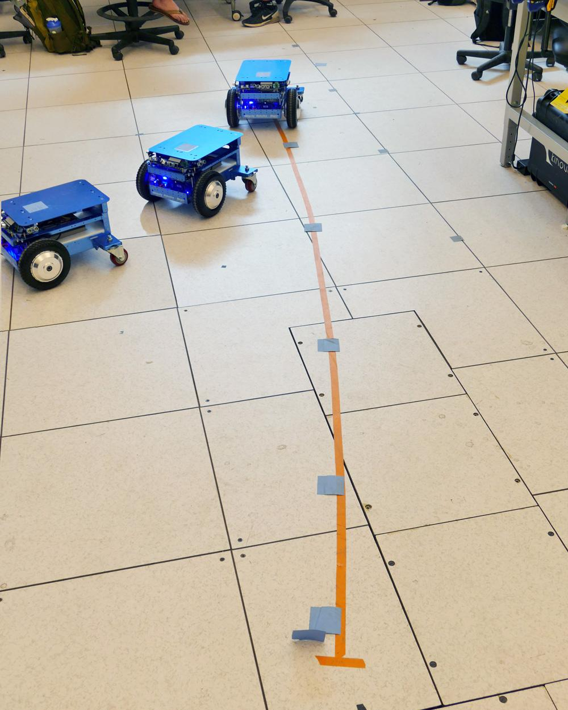
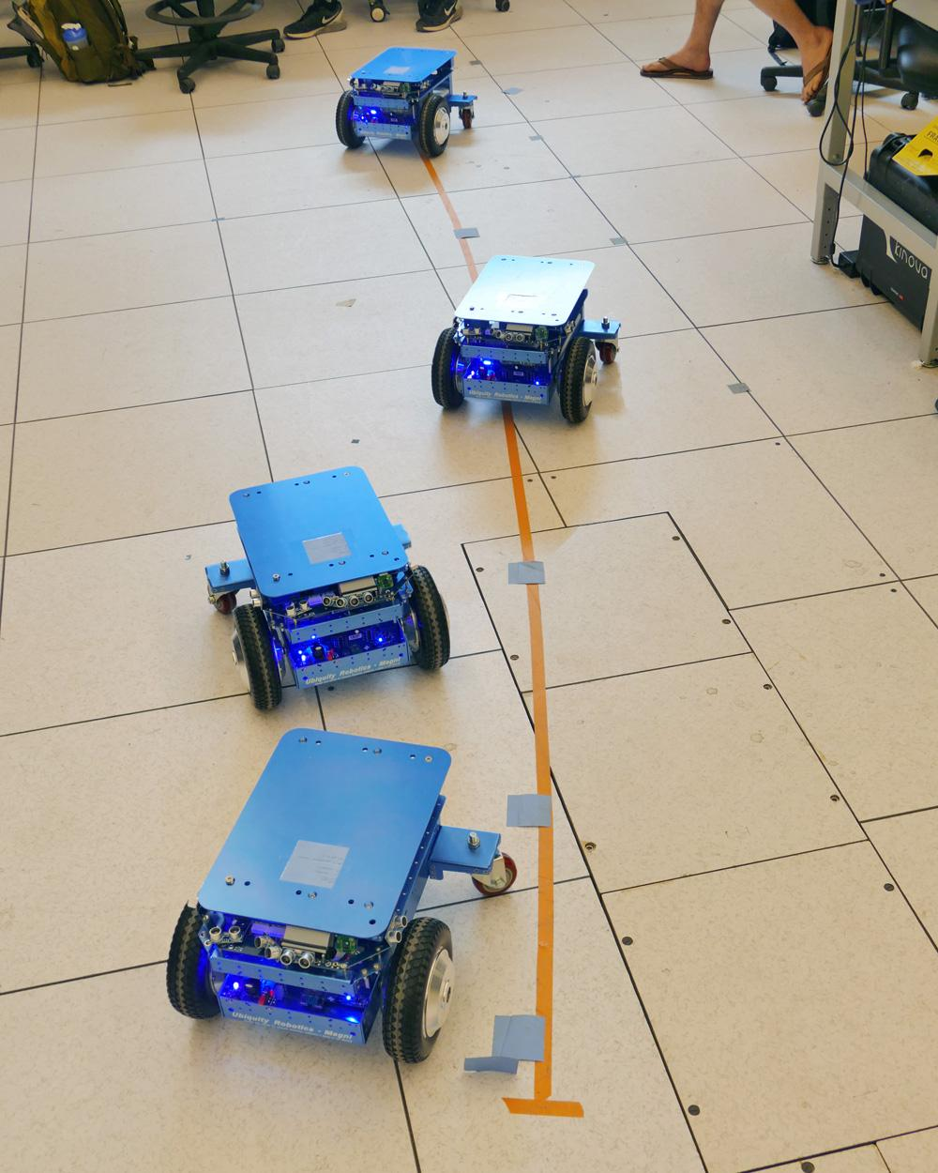
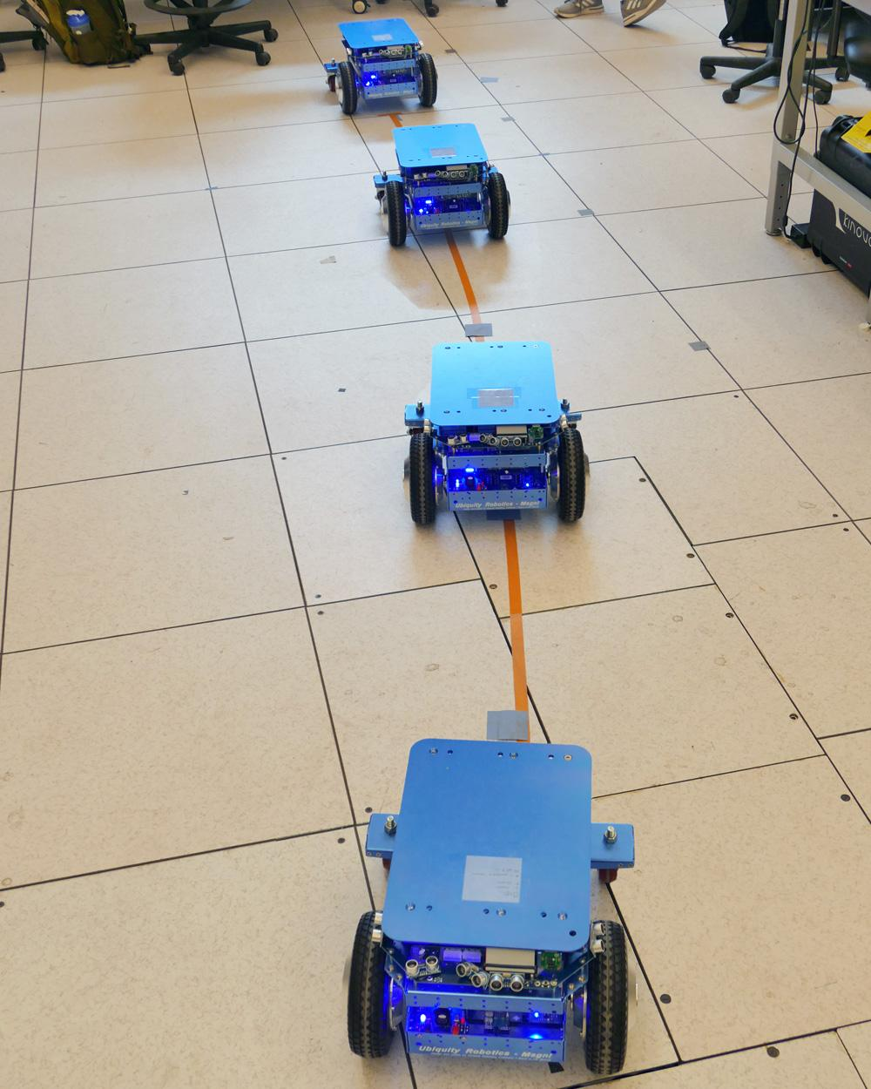
Basic RL Algorithm - Performance
Success!
Sometimes
Issues:
Slow convergence
Bad q-values can stay for a long time because of random updates.(stuck in local optima).
Noise from trials were as large as the variation in Q-Values. Leads to noisy results, even once converged
No Training
Training
Success!
Notes:
Rachel

Slide 7
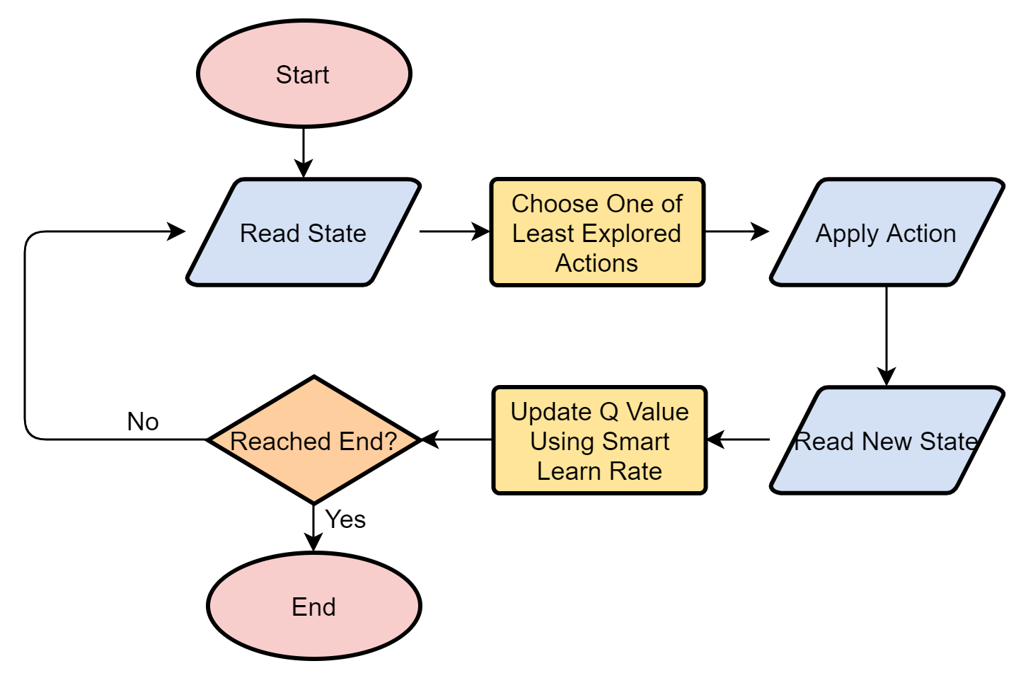
Optimizations
Smart exploration
Learning rate as a function of #times learned
Adjusting state range sizes & action strengths
Adding discounting to reduce preference for poorly learned actions
Notes:
Emerson
Adding discounting to reduce preference for poorly learned actions
A bad motion will lead to a state with poor q-values, therefor a bad motion with an incorrectly good q-Value will be less likely to be chosen in implementation

Slide 8
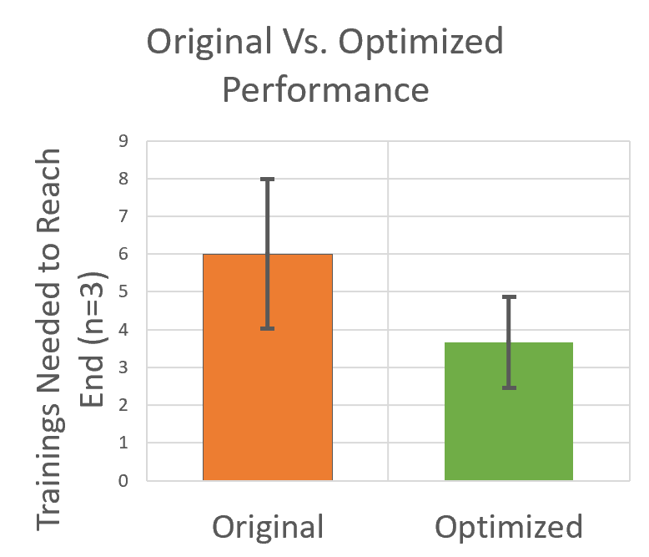
Optimizations - Performance
39% improvement in cumulative error
Three trials (learned Q-Matrices) each
Smoother movements
Issue with “forgetting” when trained long enough for learning rate to get tiny
Notes:
Casey

Slide 9
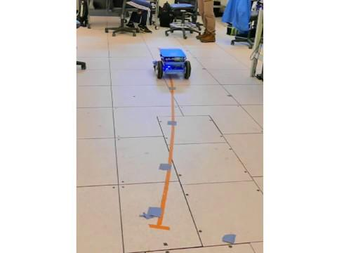
Conclusion
Success!
Possible further work:
Intentionally choosing actions that arrive in states we haven’t learned yet
Collecting more data to see which optimizations were most effective
Notes:
Casey

